Slide 1
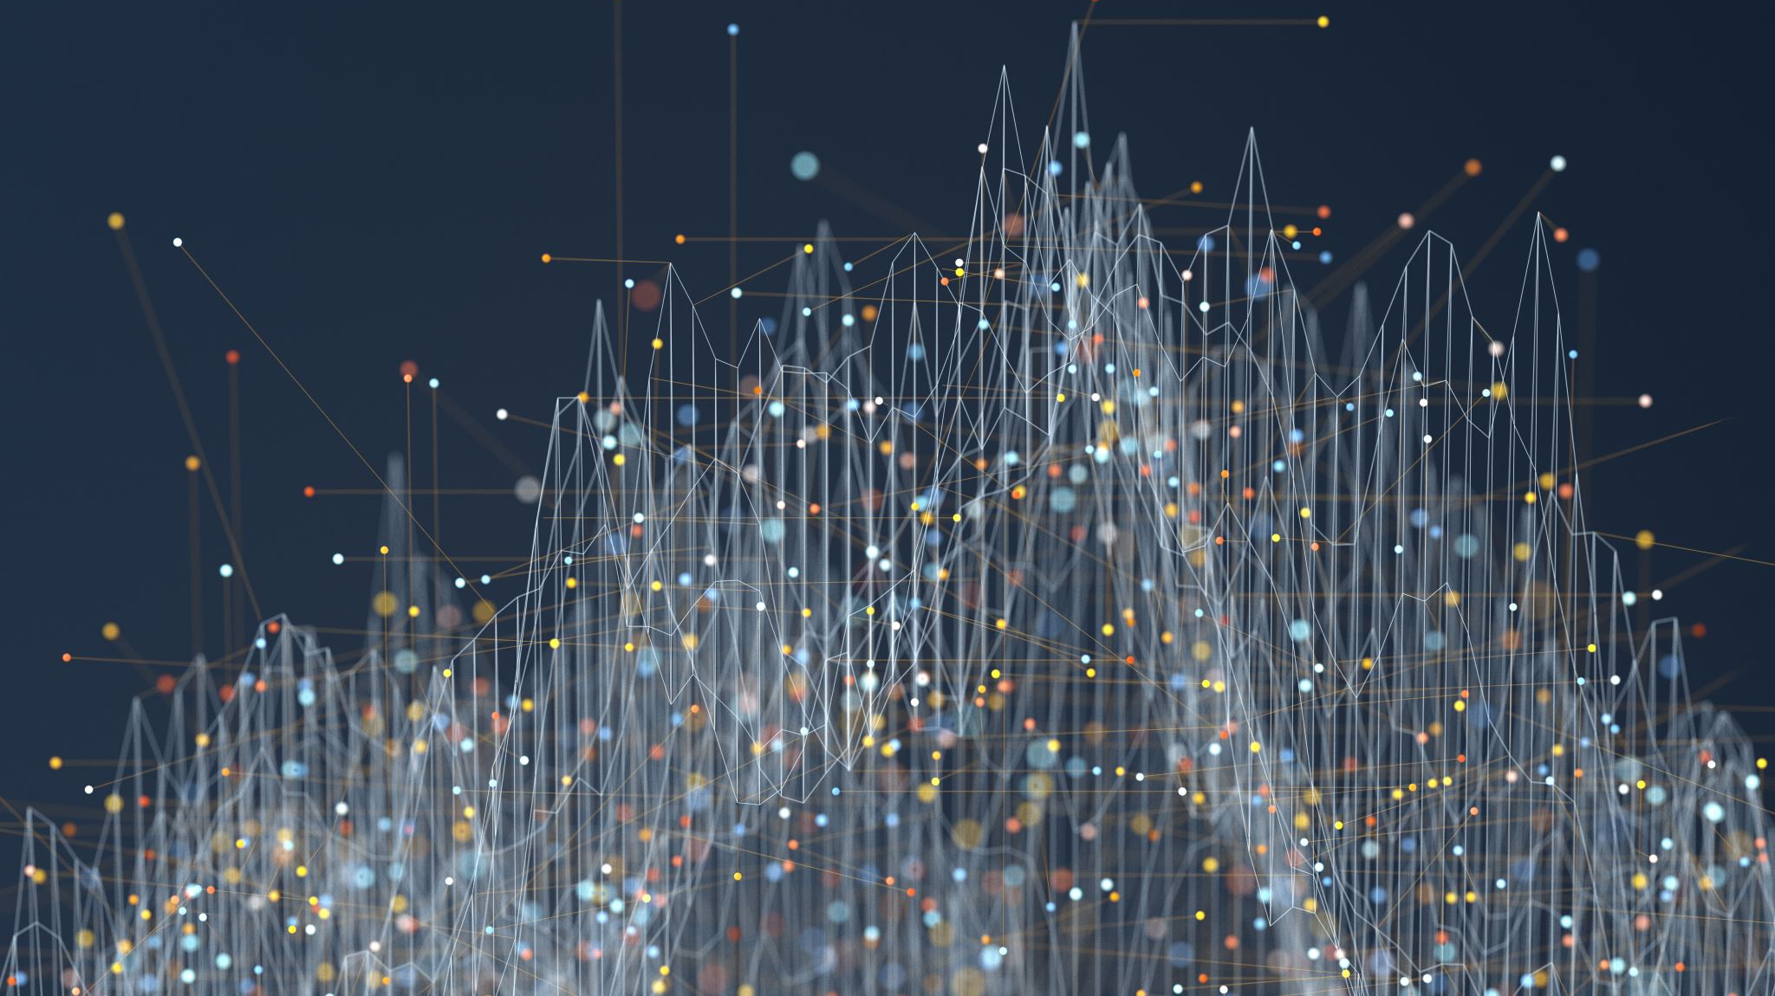
Digital Twins
Annabel Whipp
Leeds Data Science Society
Notes:
I’m Annabel Whipp I’m a PhD student based in the School of Geography and I’m also the secretary of the Leeds Data Science Society. Today I’m going to be talking to you about a technology known as digital twins. It is gaining more traction within the world of AI and computer science and has the potential to be the future of urban planning and engineering.

Slide 2
What is a digital twin?
A conceptualised version of a physical product
Notes:
So to begin with, what is a digital twin? There are many definitions but this one here, is simple while encapsulating the key features of the technology. A digital twin is a conceptualized version of a physical product. This means that a digital version of a real-life physical entity is constructed using data and algorithms instead of tangible materials.

Slide 3
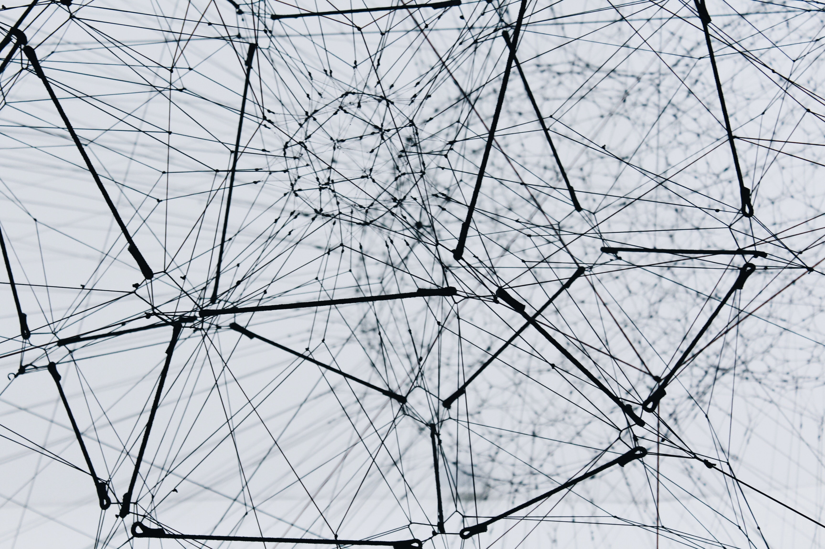
Internet of Things
Digital twins are possible due to the advent of the Internet of Things
Notes:
Digital twins have been made possible due to the internet of things. The term IoT encompasses everything connected to the internet, but it is increasingly being used to define objects that "talk" to each other. "Simply, the Internet of Things is made up of devices – from simple sensors to smartphones and wearables – connected together. There are a vast range of objects which can be included in the internet of things, from sensors on manufacturing lines in factories in order to reduce waste to fitness trackers. The vast amount of data we are now able to capture regarding products, services, the built environment, individuals and their way of life helps to create digital twins, and without this data, the quality and accuracy of digital twins are reduced.
Talk about one example is a smart fridge- the idea that your fridge can tell you when you’re running out of something or if some food is past it’s use by date

Slide 4
What can digital twins be used for?
Cities
Cars
Planes
Hospitals
Wind turbines

Slide 5
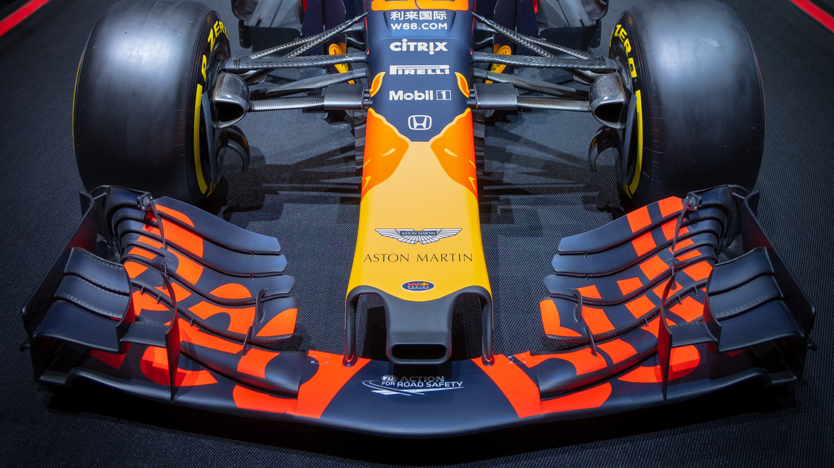
Notes:
https://www.youtube.com/watch?v=DcdfyjocCEM

Slide 6
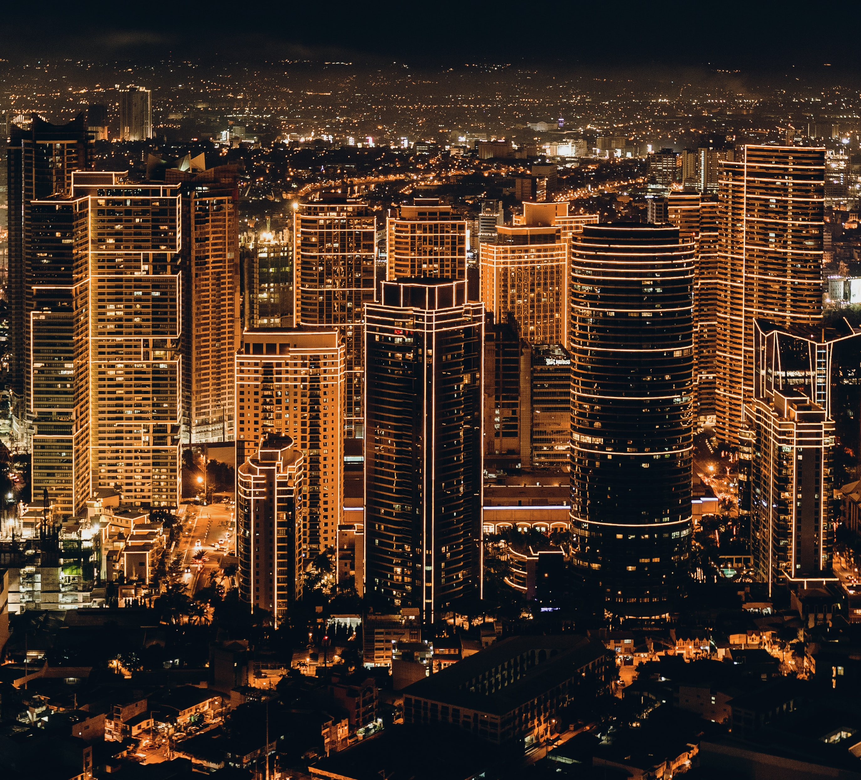
Simulations of cities

Slide 7
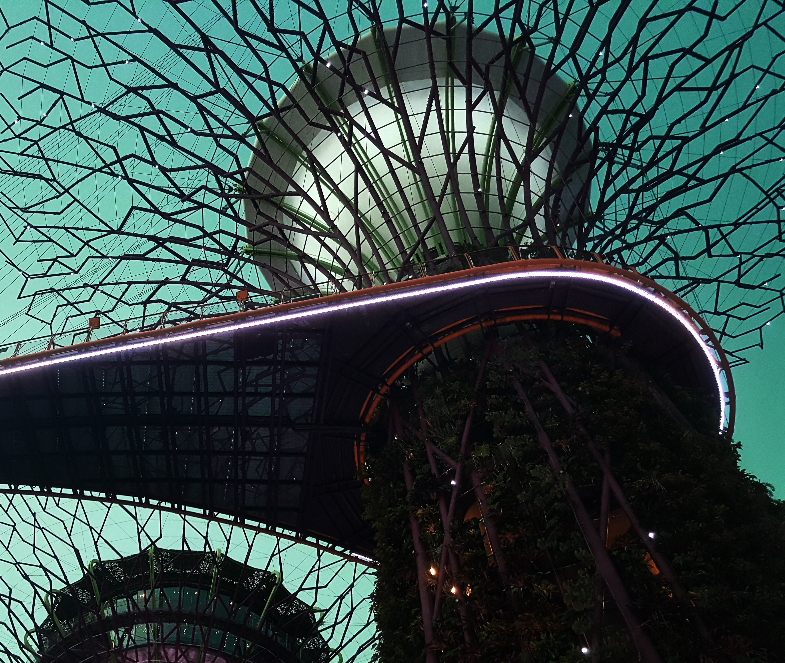
Singapore: The virtual city
Notes:
https://www.youtube.com/watch?v=9byat0VhqFk

Slide 8
The future of digital twins
Socio-economic benefits
Improved quality of life for citizens
More data is need
There are geo-privacy issues associated with data collection

Slide 9
